Slide 1


CAT 2002 : Analysis
Anchored by :
Mr. Gautam Puri
Mr. Shivkumar

Slide 2
Overview
Maths/DI/Reasoning - 100
Total Questions - 150
No. of Sections: Three
Section wise time limit: None
No. of question: 50 in each section
Easy sections: DI and EU
Difficult section: RC
Answer choice: None of these in QA & DI
English - 50
Surprise is that there are no surprises

Slide 3
Overall - Strategy
Strategy - I | Time Allocation | Good attempts
Section – QA | 40 min | 20-22
Section – EU/RC | 40 min | 27-32
Section – DI/ DS | 40 min | 25-30
Strategy - II | Time Allocation | Good attempts
Section – QA | 45 min | 20
Section – EU/RC | 35 min | 30-35
Section – DI/ DS | 40 min | 23-28
Remarks : Strategy – II for persons weaker in QA

Slide 4
QA - Key Observations
3 grouped questions (total 6)
Arithmetic (26) ,Geometry (9), Algebra (9)
More weightage to arithmetic , permutation
Good attempt: 20-22
Good score: 18-20
Cut- off: 15

Slide 5
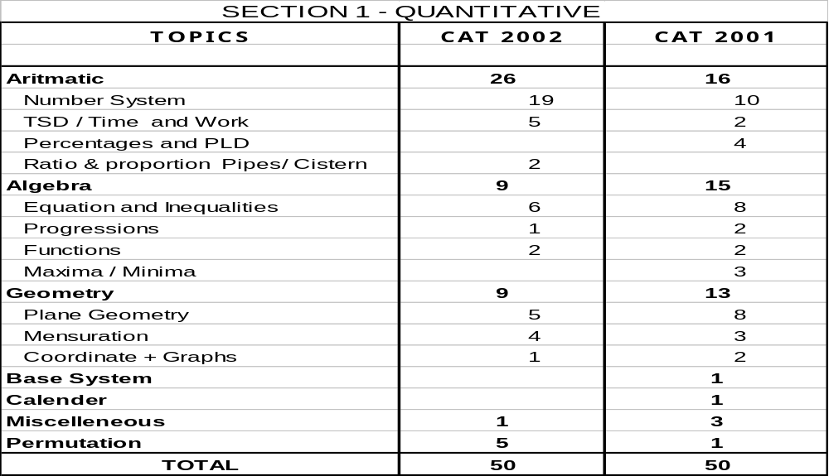
QA– Detailed Breakup

Slide 6
EU / RC- Key Observations
EU: 25, RC: 25
Lower no. RC questions: 25 (30 in 2000)
Inference based questions: 9
Passage on cell biology: all 5 questions fact based but with multiple answers: Difficult
EU section was dominated with vocab (15 out of 25 questions and 13 were sitters )
Realistic attempts: EU 17-20, RC 10-12
Cut off: 22

Slide 7
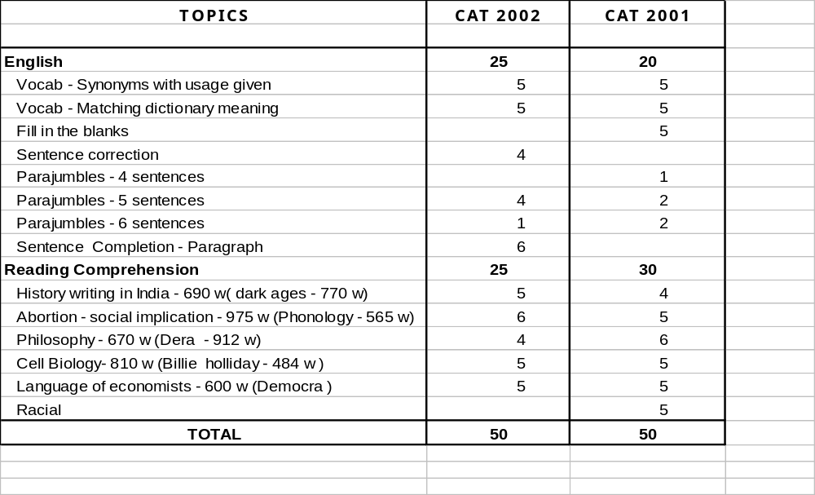
EU/RC– Detailed Breakup

Slide 8
DI/DS/AR- Key Observations
DI: 32, DS: 8, AR (single): 6, Logical: 4
AR questions lengthy and were not worth an attempt
In DI, 24 questions were based on tables
More counting based questions than 2001
Realistic attempts: 25-30
Cutoff: 18

Slide 9
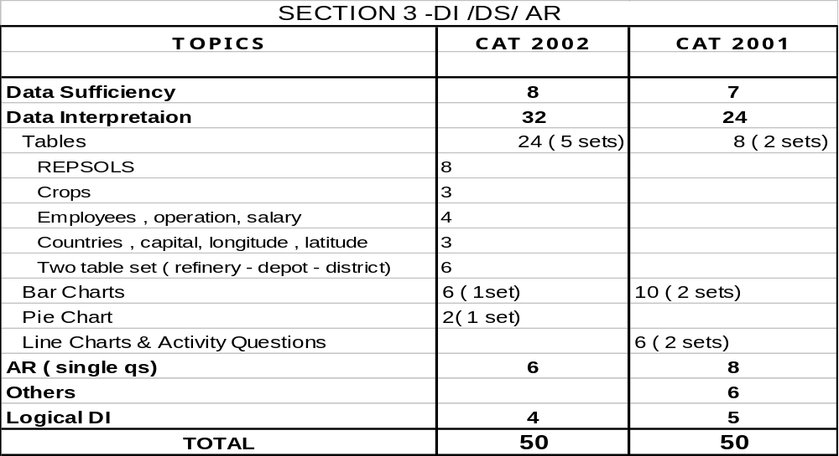
DI/DS/AR– Detailed Breakup

Slide 10
Summary – Key observations
Level of difficulty same as last year
Good attempts: 80-90

Slide 11
Summary – Cut-Offs
 | Section QA | Section EU/RC | Section DI/DS/AR | Total
Type of questions | QA | EU//RC | DI/DS/AR
Total Questions | 50 | 50 | 50 | 150
Good Attempts | 20-22 | 27-32 | 25-30
Possible Scores | 18+ | 24+ | 20+
Cut-off for Definite calls from IIMs | 15 | 22 | 18 | 68-70

Slide 12
Summary – Cut-Offs
Institutes | Cut - offs
MDI/ SP Jain | 60+
TAPMI/ MICA | 50+
FORE/ IMI | 45+

